Slide 1
Analyzing temporal patterns of crimes from different time perspectives (yearly, monthly, weekly) can reveal essential insights into trends, seasonalities, and anomalies, which may inform strategic policing and community efforts. Let’s delve into how you might structure a presentation analyzing crime data over these time frames:

Slide 2
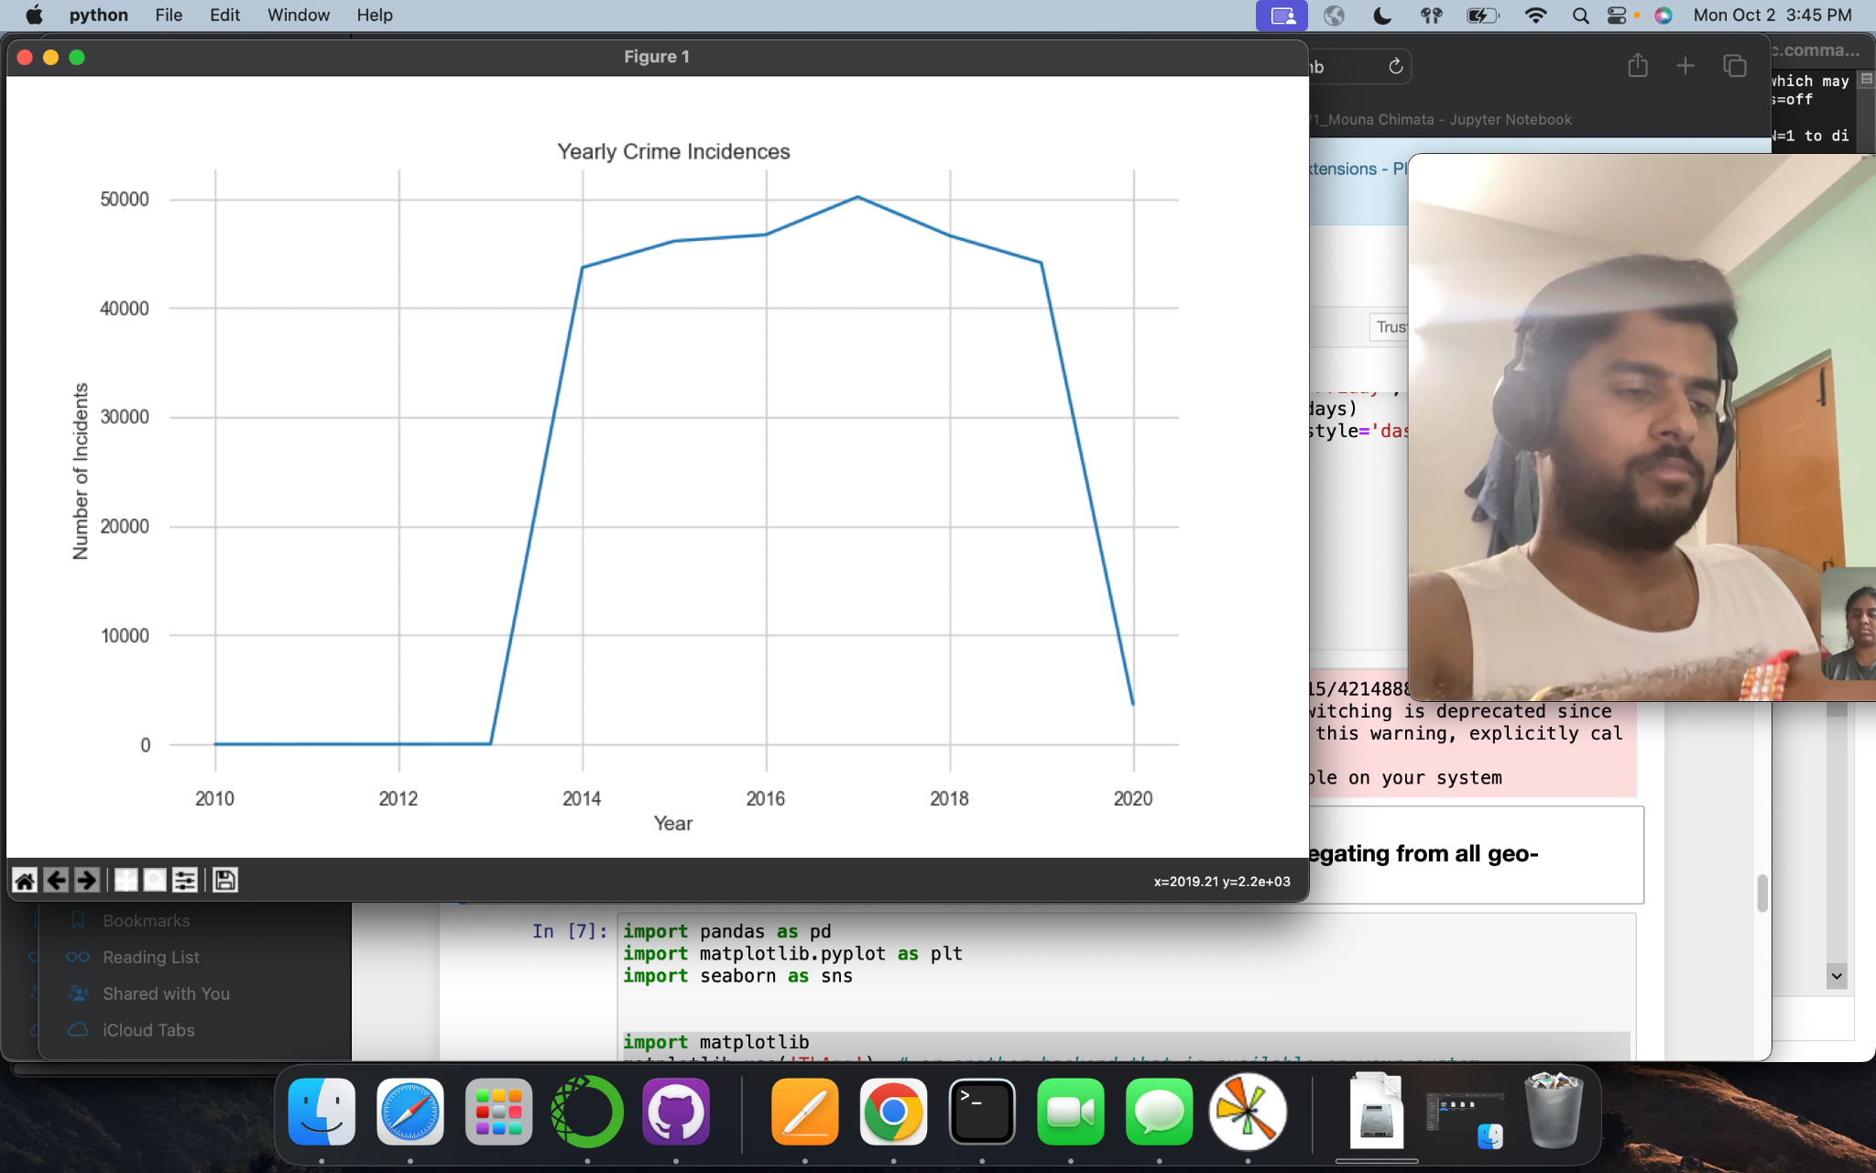
Evaluating the Crime Data: A Focus on the Decade from 2010 to 2020
Given our dataset, which spans from 1963 to 2010, we’ll specifically zoom into the decade from 2010 to 2020 to scrutinize the prevalent crime trends. Let's delve into the nuances of the graph and discuss notable instances and patterns observed in the crime data during this period.
Highest Crime Rate : Between 2016 - 2018

Slide 3
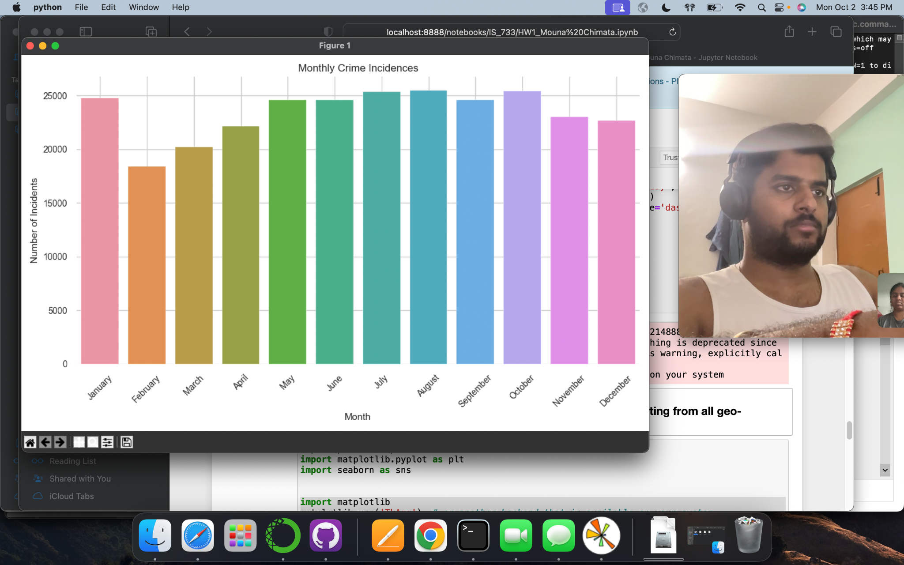
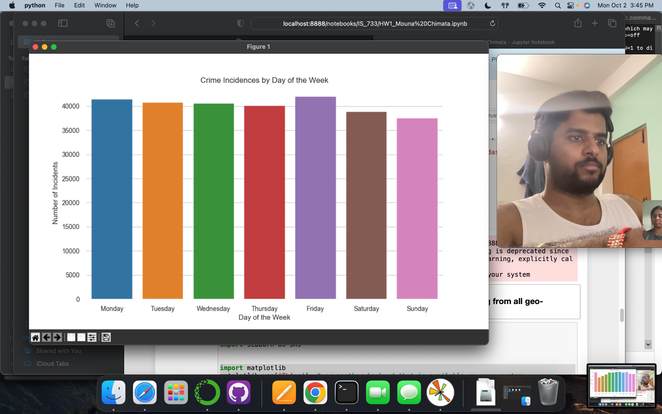
Bad
Bad
Enhancing Visual Representation: A Refined Approach to Plotting- please find the next slide

Slide 4
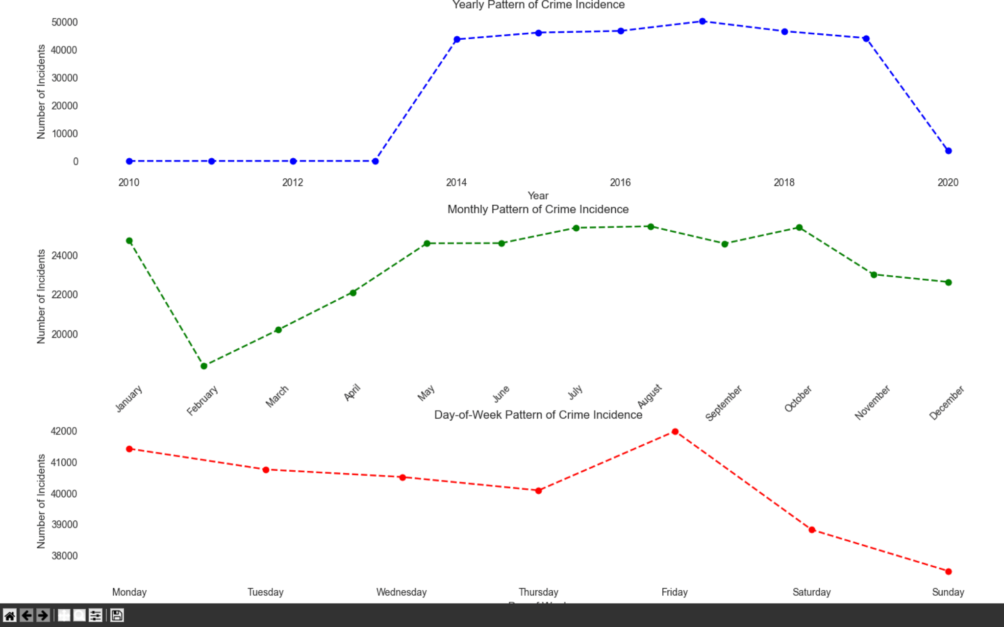
Better
Better
Insightful Crime Peaks and Valleys
A notable surge in crime occurs from May to October, while February reflects the minimum, revealing a distinct seasonal pattern in the data.

Slide 5
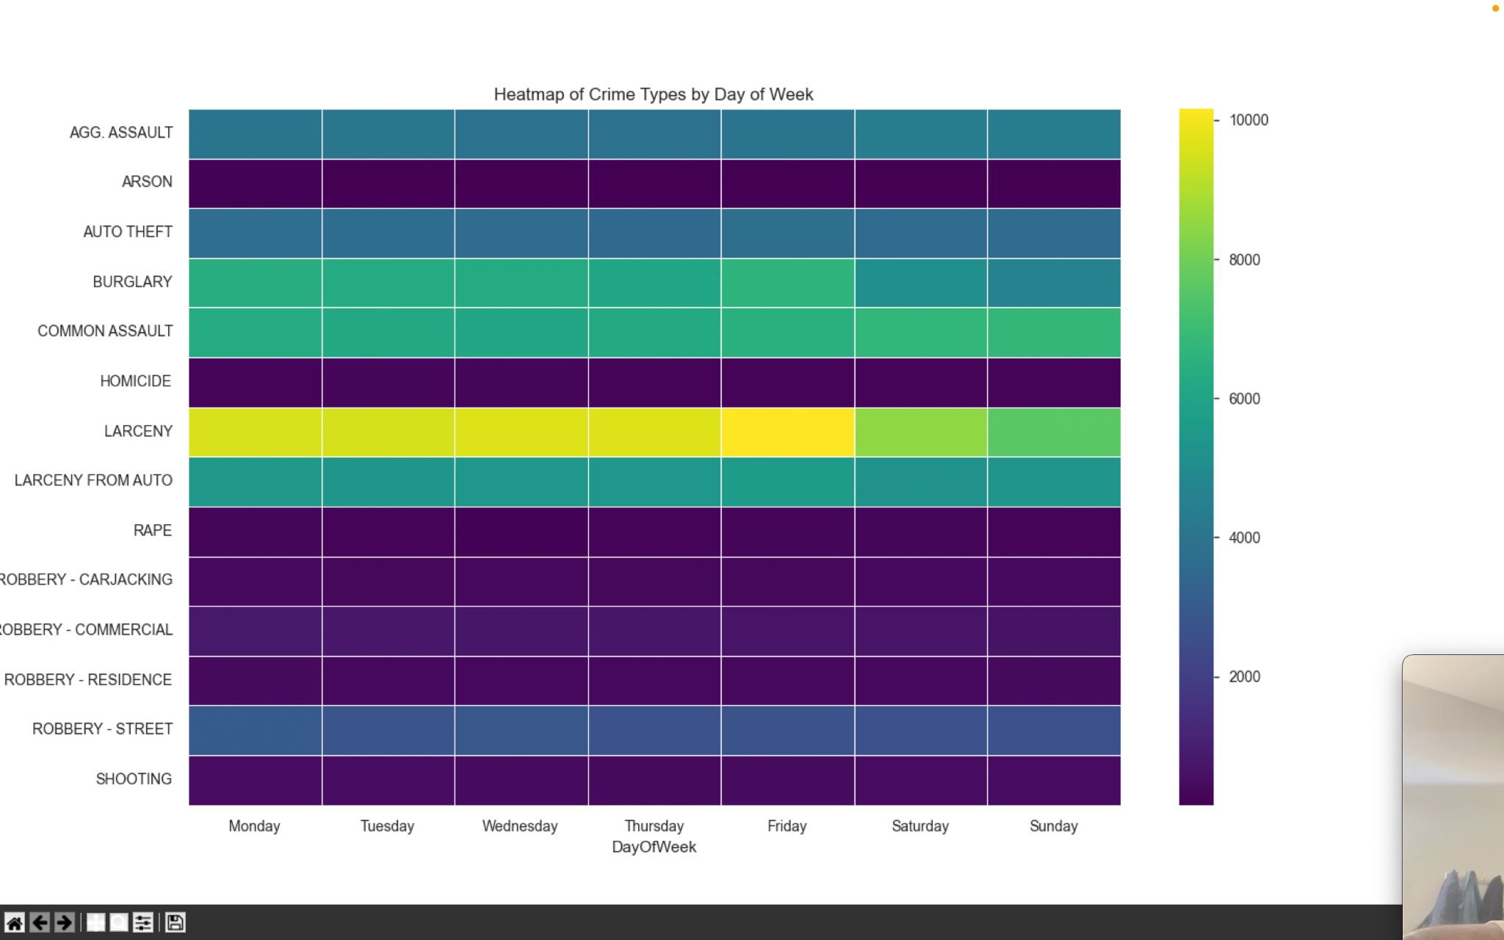
Highlighting Crime Type Trends: Larceny Takes the Lead
A distinct trend emerges from the crime type distribution graph: Larceny surfaces as the predominant incident, commanding attention in our strategic counteractive approaches.
This shortened version maintains the primary insight and a hint toward its strategic implications in a compact format.

Slide 6
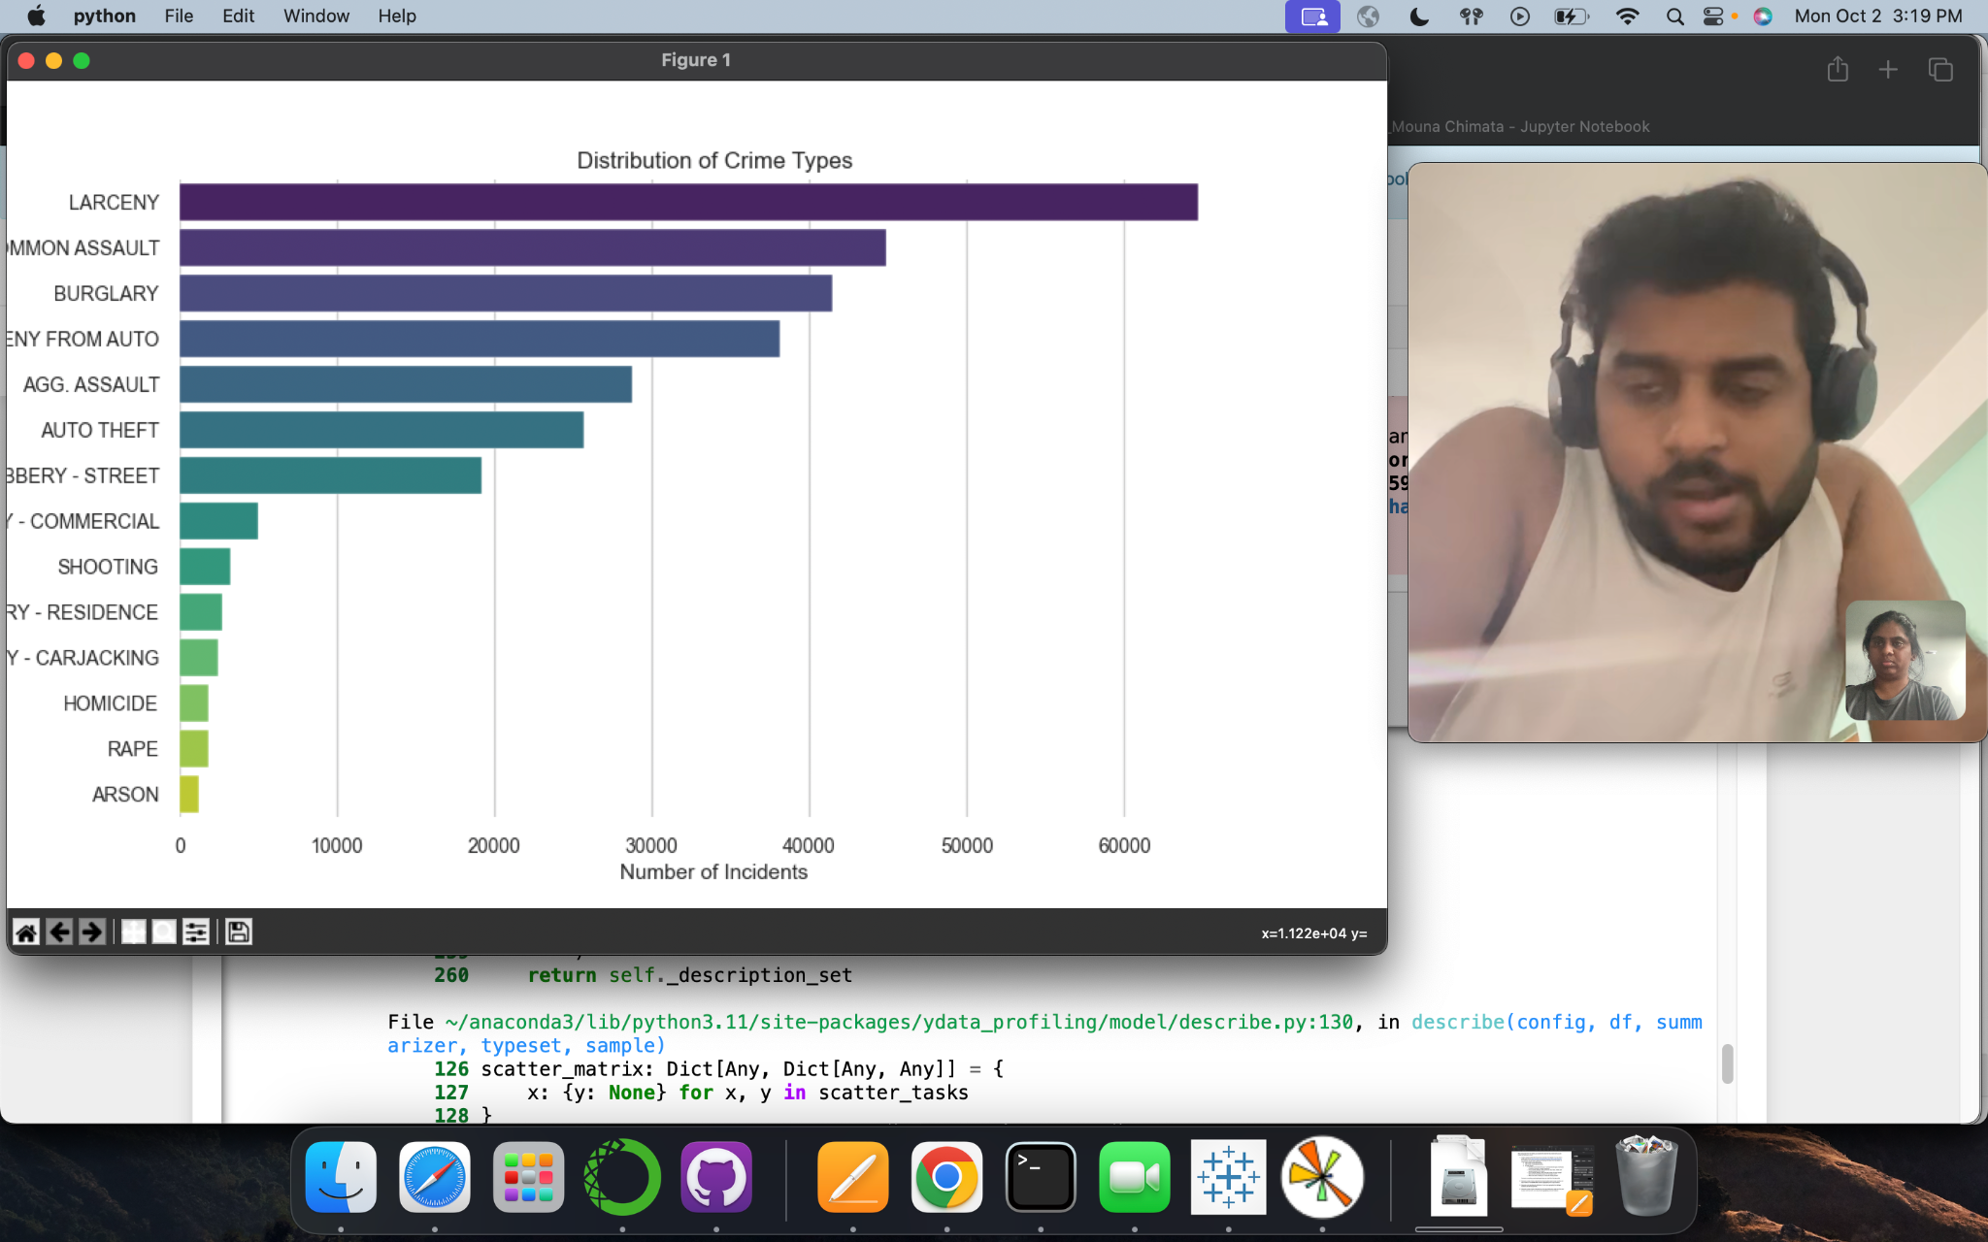
Weekly Crime Patterns: Larceny and Burglary Insights
Larceny notably peaks on Fridays and tapers during weekends, marking it as the predominant weekly crime. Conversely, burglary, revealing a slight weekend dip, suggests a strategic preference for weekday occurrences, potentially exploiting periods of homeowner absence.
This compact version succinctly conveys the primary observations and their potential implications, offering a brief yet comprehensive snapshot of the insights.

Slide 7
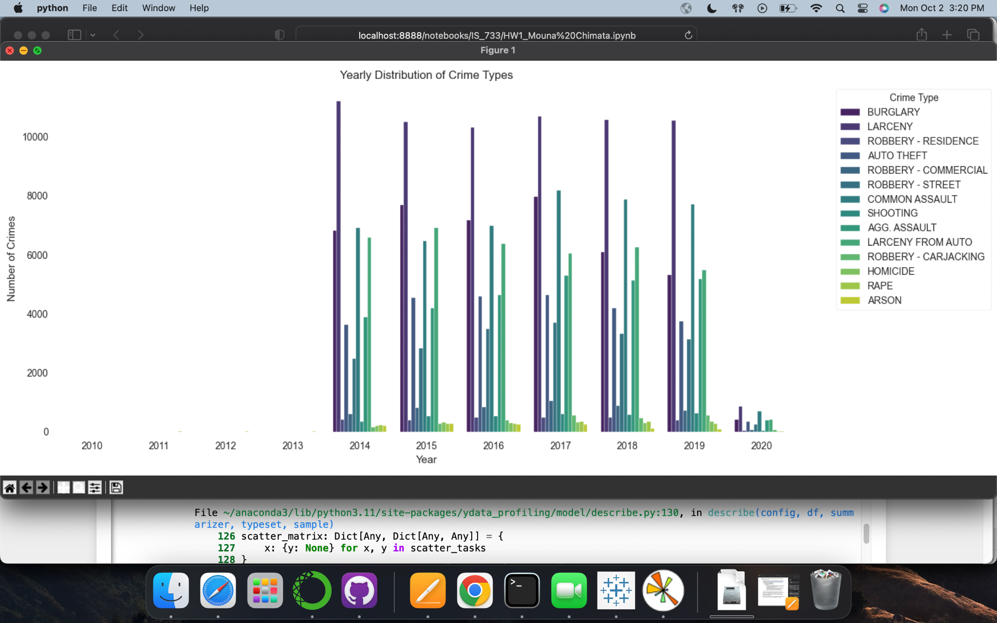
Yearly Crime Type Analysis
Notable fluctuations in crime types appear in the monthly and weekly patterns, highlighting discernible seasonal and weekly trends that shed light on the temporal dynamics of criminal activities.

Slide 8
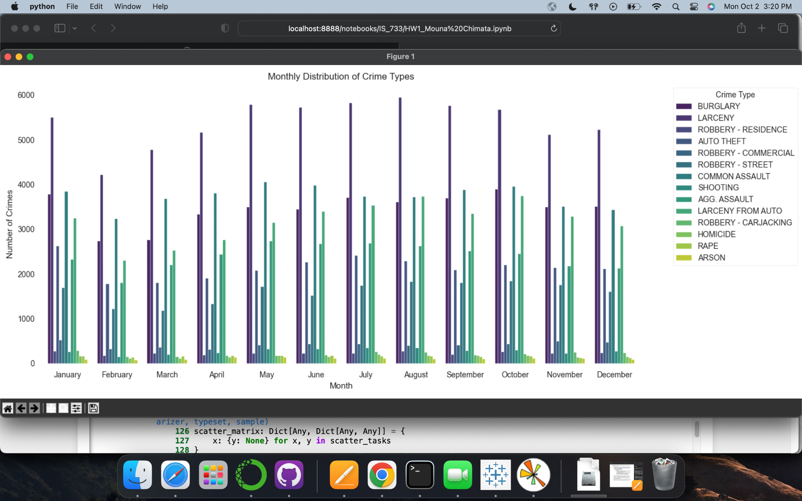
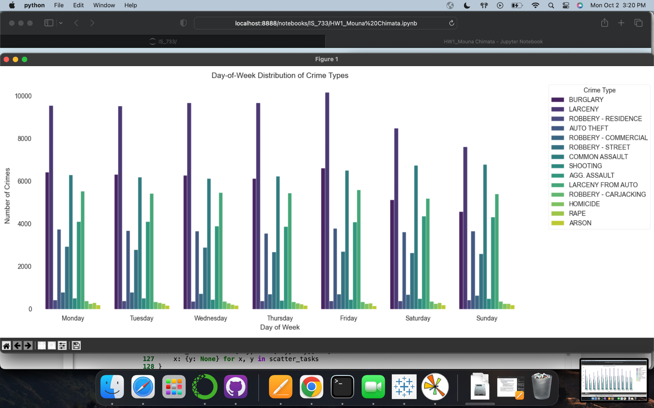
Monthly and Weekly Crime Type Analysis
Notable fluctuations in crime types appear in the monthly and weekly patterns, highlighting discernible seasonal and weekly trends that shed light on the temporal dynamics of criminal activities.

